Slide 1
Dallas Market Analysis
By: Navie Huynh

Slide 2
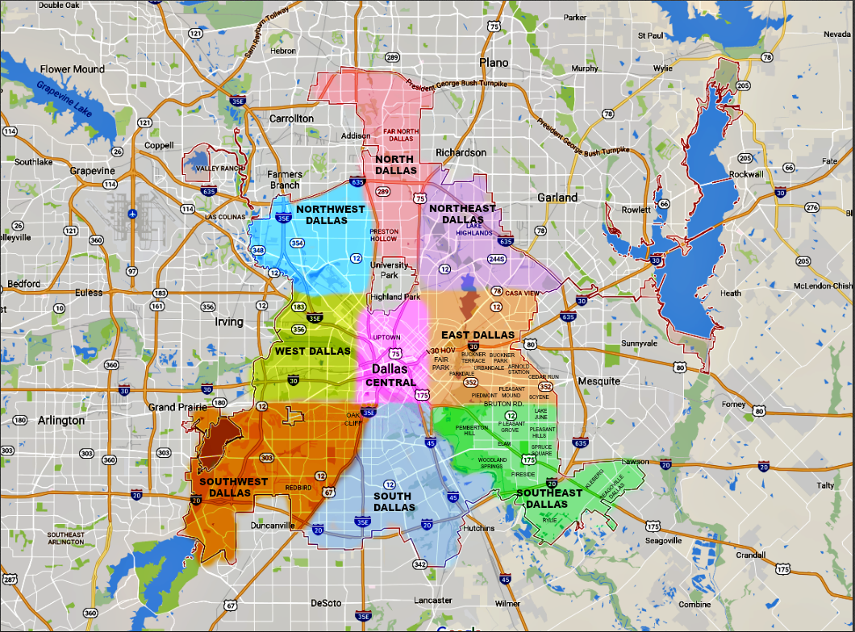
Introduction
Dallas is the 9th populous city in America. With such a large population, new businesses may not know the prime locations to set up operations. Prime locations include spots where there are few competitors and/or large pedestrian traffic. This paper will seek to identify clusters of markets within the Dallas region.

Slide 3
Key Stakeholders
Small Businesses
Real estate investors

Slide 4
Data Sources
Wikipedia
Zipcodes.com
Foursquare API

Slide 5
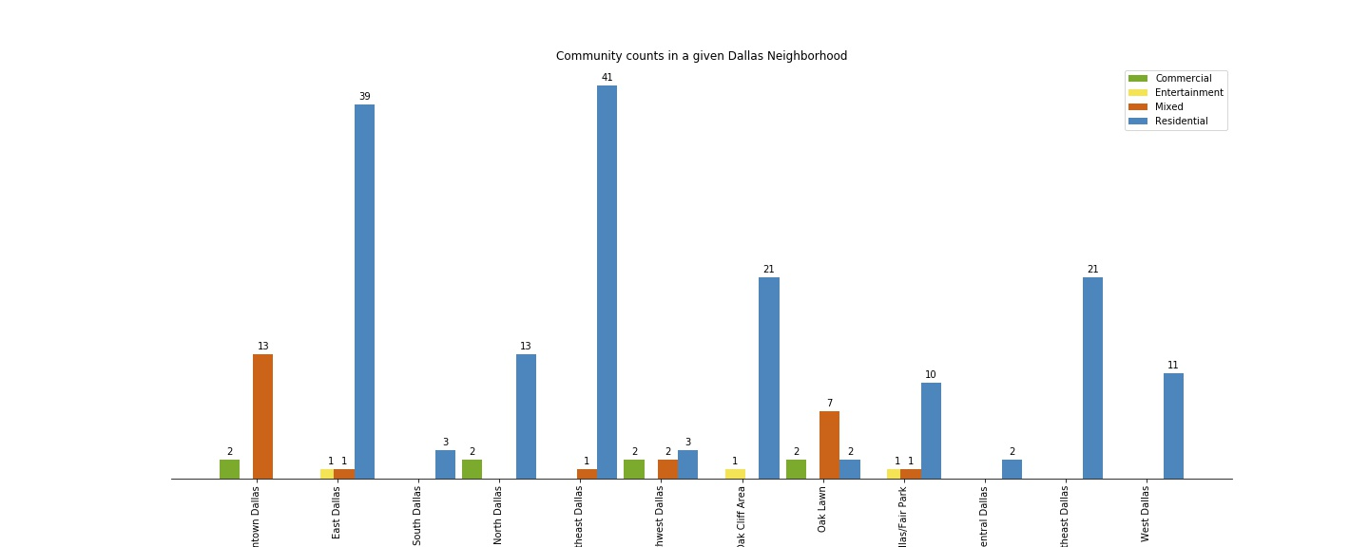
Wikipedia
We use the Dallas Neighborhoods Wikipedia page to analyze the types of neighborhoods in the Dallas area.

Slide 6
Zipcode.com
Zipcode.com contains geolocation, demographic and other information relating to zipcodes.
We use zipcode.com to find the latitude and longitude of a given zip code for later analysis with the foursquare api.

Slide 7
Foursquare API
The foursquare API allows us to find the top 15 business by name for a given geolocation.
We automate the requests with python to create a dataframe with the top 15 business types for each of the zip codes.
This dataframe is used to train our Machine Learning model as well as visualization

Slide 8
Methodology
Due to limited knowledge on clustering, we will use the Kmeans clustering algorithm, but compare the performance of the training with Euclidean distance and cosine distance
To select the optimal Kmeans cluster, we train the data against a sample of clusters and look for the optimal ‘bend’ in the error rate.

Slide 9
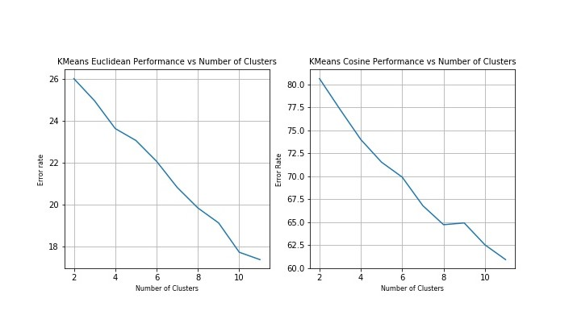
Methodology
The optimal number of clusters for Euclidean distance and Cosine distance is 10 and 8 respectively.

Slide 10
Methodology
Next we will perform PCA analysis against both models.
PCA seeks to reduce the number of dimensions of a dataset such that the resulting principal components are linear combinations of the other features
This analysis reduces the noise in the data, but we are not certain to what degree.

Slide 11
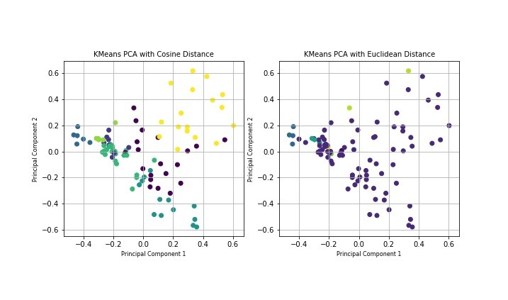
Methodology

Slide 12
Methodology
Finally, we will measure the silhouette score for both models.
This metric is interpreted as how similar a dataset is to it’s own cluster.
The metric will compare the intercluster distance and intracluster distance for each sample and aggregate over all samples
For cosine distance, we found the score to be .1278
For Euclidean distance, we found the score to be .2805

Slide 13
Results
We select the Kmeans clustering algorithm with 10 clusters using the Euclidean distance as the optimal model for our problem
When we analyzed the optimal cosine distance kmeans algorithm, we found that most of the venue types for the 3 largest clusters are very similar.

Slide 14
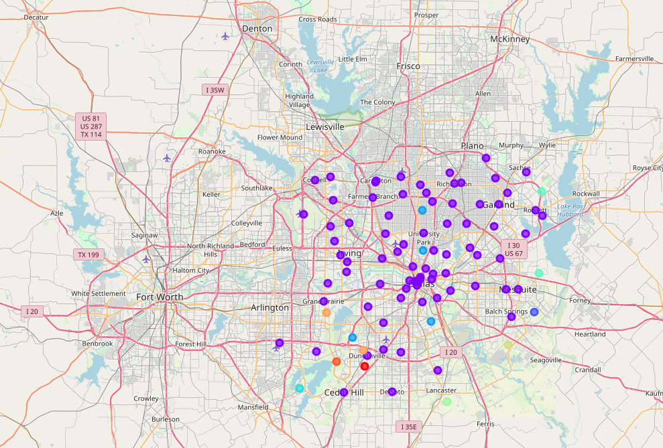
Results

Slide 15
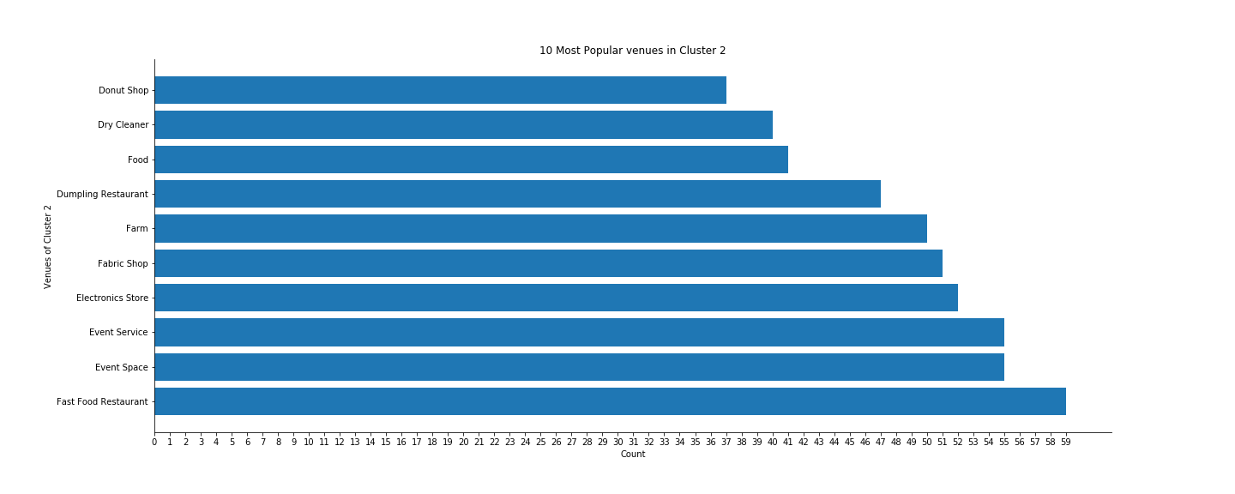
Results

Slide 16
Discussion
Fast food restaurants dominate the Dallas Market
Entertainment venues are second best
What types of new businesses will prosper in this kind of market?
How do we move the demand to move away from Fast food restaurants?
Future applications of this research

Slide 17
Conclusion
The model found that most of the neighborhoods in Dallas prefer entertainment and leisure type venues.
This is likely the case as we found from Wikipedia that most of the neighborhood types are Residential.

